Slide 1


Working Group on Self-certification
QUATRA – TPG A – Qualifications Frameworks for Trust, Transparency and Diversity
Progress Report
TPG-A Fifth Meeting
April 26, 2023, Vienna, Austria

Slide 2
Working Group on Self-certification
Composition and Aim
Composition of the working group
The working group on Self-certification composes of 8 members
  Andorra
  Armenia
  Bulgaria
  Croatia
  Georgia
  Greece
  Kazakhstan
  Latvia
  Sweden (observer)
WG is Chaired by Georgia and Bulgaria
Aim: to provide platform for more intensive discussions and provide specific recommendations on Self-certification
2-3 online meetings will be conducted
(one face-to-face meeting)

Slide 3
Working Group on Self-Certification
Progress Report
September 29, 2022 Online Meeting
October 21, 2022 Riga, Latvia, in-person meeting
February 23, 2023 Online meeting
Key Outcomes:
WG approved the ToR
WG members presented situation on NQF self-certification process
Kazakhstan delivered presentation on NQF Self-certification process
WG discussed the general outlines of the recommendations
WG members agreed to continue discussion in Riga
Key Outcomes:
WG agreed to collect the lessons learned and emerging needs of WG members regarding the self-certification
Survey was launched in December, 2022, 16 members of TPG_A on QF sent their responses
Key Outcomes:
Survey results were presented to the WG members
Date of the PLA on self-certification was set - 21 September, 2023, Tbilisi, Georgia
WG members provided the suggestions for the program of upcoming PLA and recommendations outlines
Next in-person meeting was agreed to conduct in Vienna, on April 26, 2023

Slide 4
Survey key findings
Survey has threefold aims:
  To collect the lessons learnt from countries, which completed the self-certification of NQF
  To find out the major challenges and needs of the countries, which have NQF self-certification in their agenda
  To contribute to development of the recommendations on self-certification
16 countries responded:
  (1) Countries, which completed the self-certification process: Albania, Austria, Croatia, Flemish Community of Belgium, Germany, Hungary, Latvia, North Macedonia, Poland and Romania
  (2) Countries which have the self-certification in their agenda: Azerbaijan, Andorra, Armenia, Bulgaria, Cyprus, Georgia

Slide 5
Lessons learnt…
What experience did you gain from the Self-Certification process?
Self-certification process was a comprehensive and long
Key steps included:
  Evaluation of the national NQF against the self-certification criteria and evidence collection
  Recommendations development on the legislative and methodological changes for alignment with the Self-certification criteria
  Conduct legislative amendments and development of relevant methodologies
  Engagement of the international experts and working with them
  Organization of awareness raising and capacity building activities for stakeholder
  Development of report through collaborative process
  Publishement of the report
Self-certification process required time and dedication of many stakeholders and countries investing important affords in preparation of self-certification report
Collaboration and agreement with national stakeholders was very important for the success
Some countries completed NQF self-certification and referencing process together
For the most countries Self-certification reports have not been updated since they were published

Slide 6
Key challenges in the self-certification process?
Countries, which are in the process
Countries, which completed the process
Clear guideline/instructions on self-sertification process
Clear guideline/instructions on international experts engagement
Lack of awareness among the National Authorities on the aims/benefits of the self-certification process
Countries’ obligations for NQF self-certification and referencing make more questions how to complete successfully this process
Compliance of the national systems with the Bologna Process self-certification criteria requested efforts and dedication of the national stakeholders
Lack of understanding among key stakeholders on the importance of the self-certification
Reach agreement among the national stakeholders on self-certification report
Lack of clear guidance in the process and clear instructions on engagement of the international experts
Process was long and included many steps, legal and methodological changes were necessary
To Initiate/start the the self-certification process

Slide 7
How the Bologna Process working structures can support the countries in Self-Certification process?
Provide:
guidance and peer support (meeting with the working groups and international experts) on how to put into practice the self-certification process
successful examples from countries that have already finished the self-certification process
platform for Self-certification Report’ presentation and discussion
Guidelines and all relevant information including the self-certification reports should be available on the EHEA web-page

Slide 8
Next Steps
April 26, 2023: In-person meeting in Vienna, Austria
June /July, 2023: Online meeting (TBD)
September 21, 2023: PLA on Self-certification, Tbilisi, Georgia.
WG will present the developed recommendations on self-certification

Slide 9

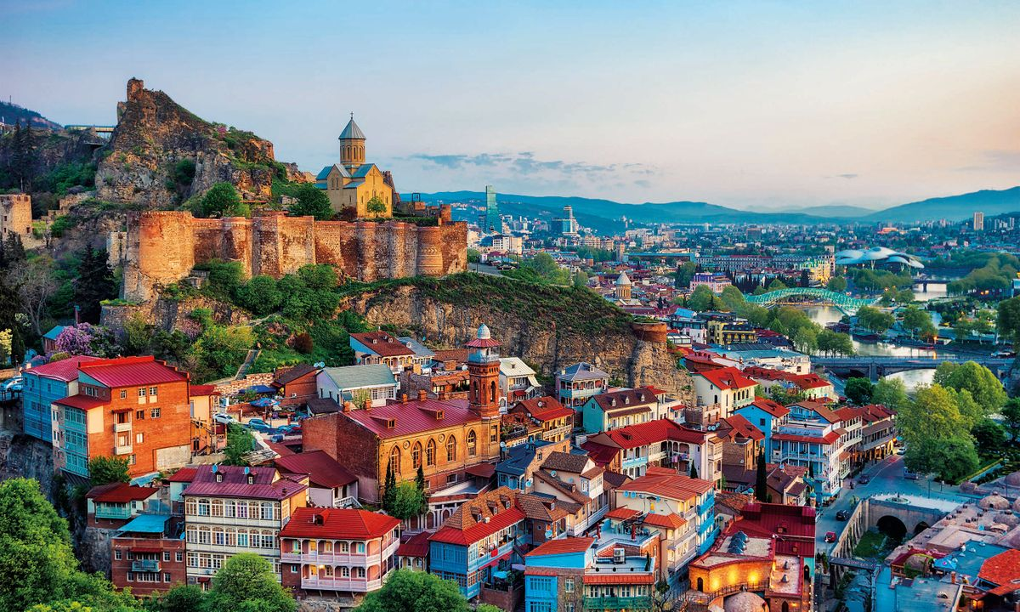
September 21, 2023: PLA on Self-certification
Hosted by National Center for Educational Quality Enhancement (NCEQE)
Place: Tbilisi, Georgia
Participants – Around 50 (TPG A members, international experts, EQF advisory group, national authorities)
AGENDA
Presentation of the recommendations on self-certification
Panel discussion: international experts who contributed to the self-certification process in different countries
Best practices (2-3 country examples)

