Slide 1
Information about the EHEA website
BFUG Board meeting - Chisinau- Moldova
  January 18, 2016

Slide 2
Terms of reference of the BFUG Secretariat
The Terms of Reference precise that the Secretariat has to
“review and update the European Higher Education Area website ensuring that up-to-date information is made available at all times for the BFUG and the public at large. [The Secretariat] will develop an ad-hoc communication system, using up-to-date digital tools. It shall propose a new website in order to provide a more efficient service."
(BFUGMeeting_LU_LI_48_4_ToR_Secretariat 2015_2018).

Slide 3
Overview 2015
Annual total sessions: 114 162
Daily average sessions: 313
Purcentage of new visitors for the year: 72.8%
Number of Pages / session: 2.14
Average session duration: 00:02:06
Bounce rate¹: 61.27%
The EHEA website lacks of visibility regarding the total annual amount of sessions.
Only a third of the visitors goes beyond the homepage.
The bounce rate represents the percentage of visitors who enter the site and then leave ("bounce") rather than continuing on to view other pages within the same site.
01/01/2015-31/12/2015
Source : Google Analytics

Slide 4
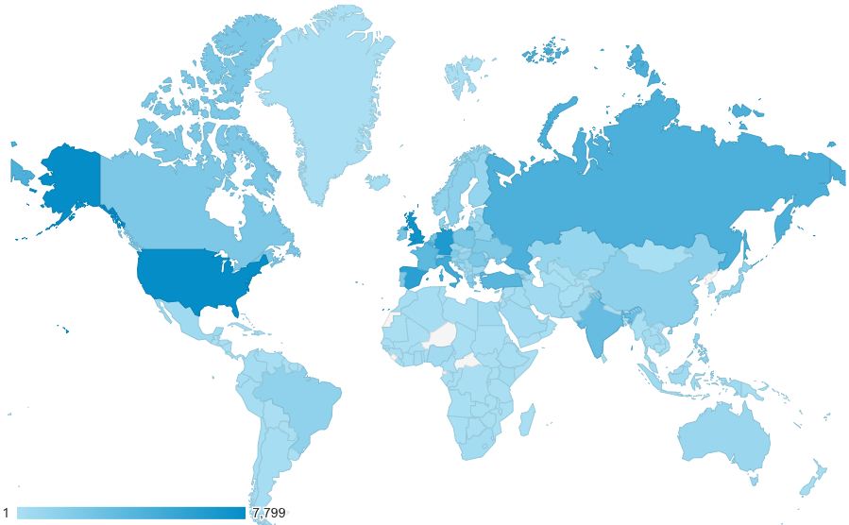
Location: countries
01/01/2015-31/12/2015 – Country of origin
Source : Google Analytics

Slide 5
Acquisition
Organic search: 44.6% (included Google 42.5%)
Referral: 35.1% (more than 1100 referrals)
Direct: 19.8%
Social: 0.5%
Main referrals:
ec.europa.eu (3%)
gsas.columbia.edu
usask.ca
enic-naric.net
en.wikipedia.org
yok.gov.tr (1%)
ed.ac.uk
ihlondon.com
qqi.ie
eees.es
bologna-yerevan2015.ehea.info
eur-lex.europa.eu
nauka.gov.pl
ond.vlaanderen.be
pace.edu
kmk.org
eua.be
dges.mctes.pt
ncsu.edu
gov.ph (0.4%)
01/01/2015-31/12/2015
Source : Google Analytics

Slide 6
Technology
01/01/2015-31/12/2015
Source : Google Analytics

Slide 8
Questions
Transparency
Restricted area
Involvement of each country in up-dating its profile

