Slide 1




Student Mobility Programmes and ERASMUS+
Dr. Carola Beckmeier

Slide 2

Reasons for running mobility programs
Extension of academic skills
Acquisition of intercultural competence
Preparation for international tasks & work environments
Improvement of foreign language proficiency
Studying in an international classroom
Education towards being a global citizen

Slide 3
266 ERASMUS partner universities about 800 exchange students / year
Spain
France
Sweden
Poland
Turkey
United Kingdom
...

Slide 4
ERASMUS+ MOBILITÄTEN
TOTAL 2014/15: 314 Studierende
2011/12: 249 Studierende
2009/10: 215 Studierende
1992/93: 78 Studierende

Slide 5
78 Overseas partner universities about 400 exchange students / year
North America
Asia
South America
Australia

Slide 6
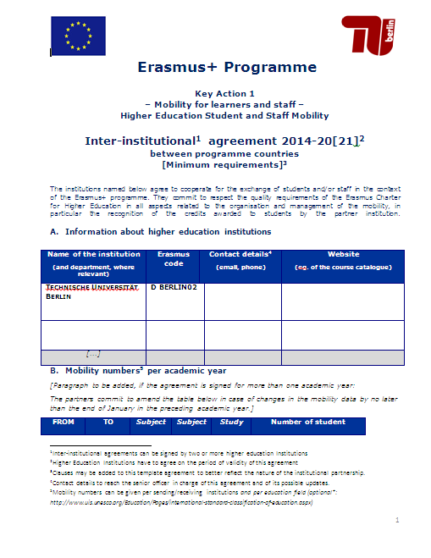
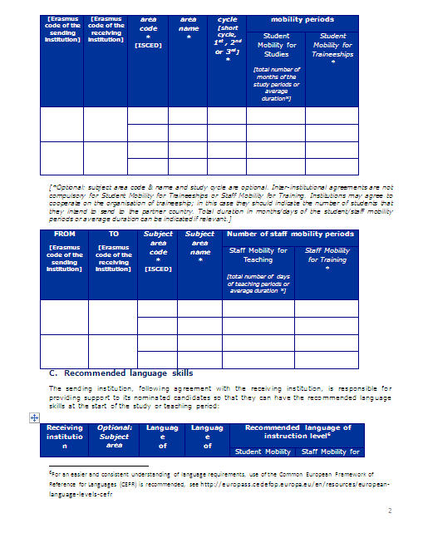
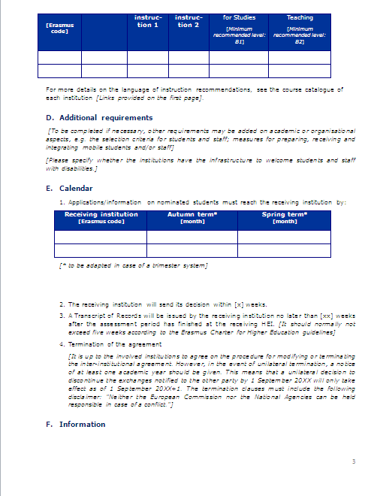
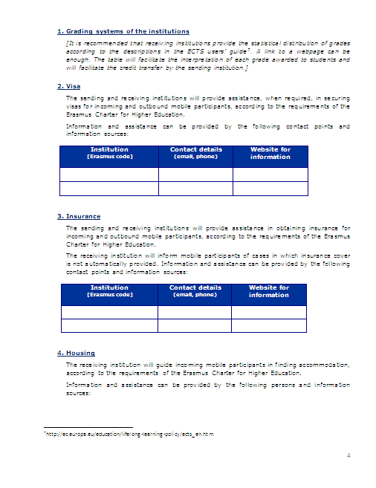
Bilateral Agreements

Slide 7
International Programs Management
Student exchange contract management
Submission of applications for external funds
Supervision of Dual Degree Programs
Infothek & Individual Counselling on Study Abroad
Selection process for scholarships
Advice on recognition of credits
Networking with partner universities
International marketing

Slide 8

ERASMUS+ Announcements

Slide 9
Incoming exchange students
Preparation of enrolment
Housing
Language courses
Transcripts of Records
Orientation sessions
General study counselling
Buddy program

Slide 10
International Programmes
Faculty coordinators – academic advisors
Information sessions – subject specific
Academic advise on study plans, course selection, recognition
Selection and nomination of incoming & outgoing students
Contact to partner universities at faculty level

Slide 11
Quality assurance
Exchange certificate
Evaluation of student reports
Meetings with coordinators to assess and develop exchange programs
Evaluation of recognition of credits

Slide 12

Integration of former
EU-Programmes in Education
Comenius
Erasmus
Leonardo da
Vinci
Grundtvig
Erasmus
Mundus
Tempus
ALFA
Edulink
ACP S&T
Atlantis
TEP/TDP
ICI ECP
YOUTH IN
ACTION
LIFELONG LEARNING
EU-DRITTLANDKOOPERATIONEN

Slide 13
ERASMUS +
– Integration of 14 Programmes
2014-2020
LIFELONG LEARNING
Cooperation with Third Countries
YOUTH IN ACTION

Slide 14
Main Types of Key Actions
Key Action 1
Key Action 2
Key Action 3
Learning Mobility
Cooperation Projects
Policy
Support
ERASMUS+
~ 14,5 Mrd. €
1. Credit Mobility
2. Degree Mobility
3. Student Loans
1. Strategic
Partnerships
2. Capacity Building
3. Knowledge
Alliances
4. IT-Platforms
1. Support for
the Bologna-
Process –
Recognition tools
2. Prospective Initia-
tives
3.Policy dialogue with
stakeholders, third
countries and inter-
national organisa-
tions

Slide 15
Erasmus+ 2014-2020
€ 14.5 Mrd.
→ 77,5% E&T € 11.3 Mrd.
→ 43% Universities € 4.8 Mrd.
p.a. € 685 Mio
63% KA 1
28% KA 2
4,2% KA 3

Slide 16
Erasmus+ / Key Action 1
Learning Mobility
1. Credit Mobility in EU und third countries :
  Student mobility
    Studies: 3 - 12 Months / Internships: 2 - 12 Months
    Multiple mobility periods possible (BA, MA, Ph.D,
    max. 12 Months)
    Gap Mobility
  Teaching Staff Mobility
    2 Days - 2 Months, at least 8 hours
  Mobility of Adminstrative Staff
  5 Days to 2 Months

Slide 17
Erasmus+ / Key Action 1
Learning Mobility
2. Degree mobility - joint master degree (JMD)
  Integrated international Master Programmes
  (formerly Erasmus Mundus)
    3 Universities from aus 3 participating Countries
    (at least one EU-Member State)
    Joint Degrees have to be accredited
  Students have to study in at least 2 different countries

Slide 18
„The highlight of studying is studying abroad“

