Slide 1

Yerevan Communiqué: with HE strategy to shape the future society we want
Gayane Harutyunyan
19 June 2015, Yerevan
Bologna Secretariat

Slide 2
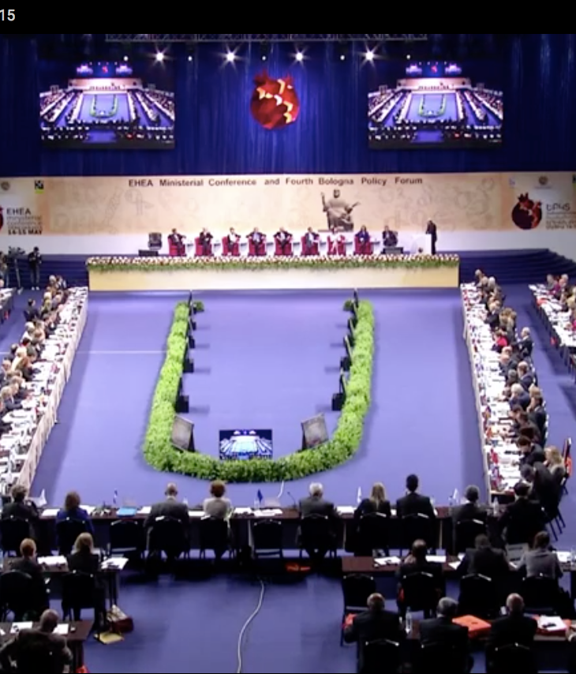
Brief overview
In total: 498 participants from 47 countries and 28 organisations
44 EHEA countries, the EC, consultative members, data collectors
2 non-EHEA countries
16 Ministers
10 researchers
Bilateral meetings, visits to 5 Armenian universities, exposition of local IT companies, cultural program
Mostly MC & BPF joint plenary sessions with few parallel sessions.
Live streamed-unique for an event of such a level. yerevan2015

Slide 3
Main Documents
Yerevan Communiqué
Statement of the Fourth Bologna Policy Forum
Belarus - new EHEA member, accession accompanied with a road map.

Slide 4

rethinking the process
Is the Process still relevant to the member countries? Is it going to stop?
How to get the member countries to implement properly the reforms committed without wasting the opportunities of the process?
How to ensure the necessary funding to avoid delays and sometimes even stopping the implementation process ?
Will the countries that have successfully implemented the reforms stay interested in the Process?
How to avoid misuse of the Bologna-name for pushing forward very often unpopular national reforms?
Will the Yerevan Ministerial conference answer all the questions?

Slide 5
main achievements
2015 Yerevan Conference marked a new phase in the Bologna process based on recognition of vision that has given rise to the EHEA where countries with very different political cultural and academic traditions cooperate on the basis of ope dialogue, shared goals and common commitments.
Bologna process remains relevant to the EHEA countries and their national goals.
More confidence about the HE future and its key role in addressing the societal, technological challenges of present as well as implementation of the reforms based on European cooperation and strengthening student representation.
It has strong calls from the Ministers to maintain institutional autonomy and academic freedom as core values of the Bologna Process.

Slide 6
Quality and relevance of learning and teaching have been put to the forefront of the process. Student-centred learning was addressed as a strong priority in the Yerevan Communiqué, and it is also now included in the newly revised European Standards and Guidelines for Quality Assurance in the European Higher Education Area, as well as the new ECTS users guide.
It has a strong stand for participation in HE, its inclusiveness. Moreover, it has illustrated how the values in the process have a dual attention on social cohesion while promoting the interests of the labour market.
Structural reforms (degree structure, credits system, quality assurance standards and guidelines) and their full and proper implementation remain the key objective, various cooperation in mobility and joint degrees are highlighted as the “foundations of the EHEA”.
The governance and working methods of the EHEA must develop to meet these challenges. A call for more precise instruments to measure implementation was made.

Slide 7
Statement of the Fourth Bologna Policy forum
Reaffirmed the intention to continue and strengthen the dialogue with other regions of the world based on common challenges.
Priority is given to the development of national qualifications frameworks (including developing methodologies to establish compatibility between national frameworks within the EHEA).
Developing cooperation in QA and encouraging quality assurance agencies from participating countries to work towards inclusion in EQAR.
Improving mutual recognition of qualifications through improved provision of information, development of common recognition practices and methodologies.
Cooperation in developing and implementing credit systems taking into account the revised User’s guide.

Slide 8
Thank you !

