Slide 1



Bologna Process after Bucharest: Challenges and expectations оf 2012-2015 BFUG Work Plan
Ministry of Education and Science of the Republic of Armenia
Hayk Sargsyan
18 November 2014, Minsk, Belarus

Slide 2

Phases of Bologna Process
1999 - Conception: developing a vision of a common higher education space
2000-2005 -Policy developments: drafting the framework of EHEA ‘the devil is in details’.
2006-2010- Implementation: Implementation of agreed principles and guidelines at national levels.
2011- Consolidation: Full and coherent implementation of main policies at national and institutional levels.

Slide 3

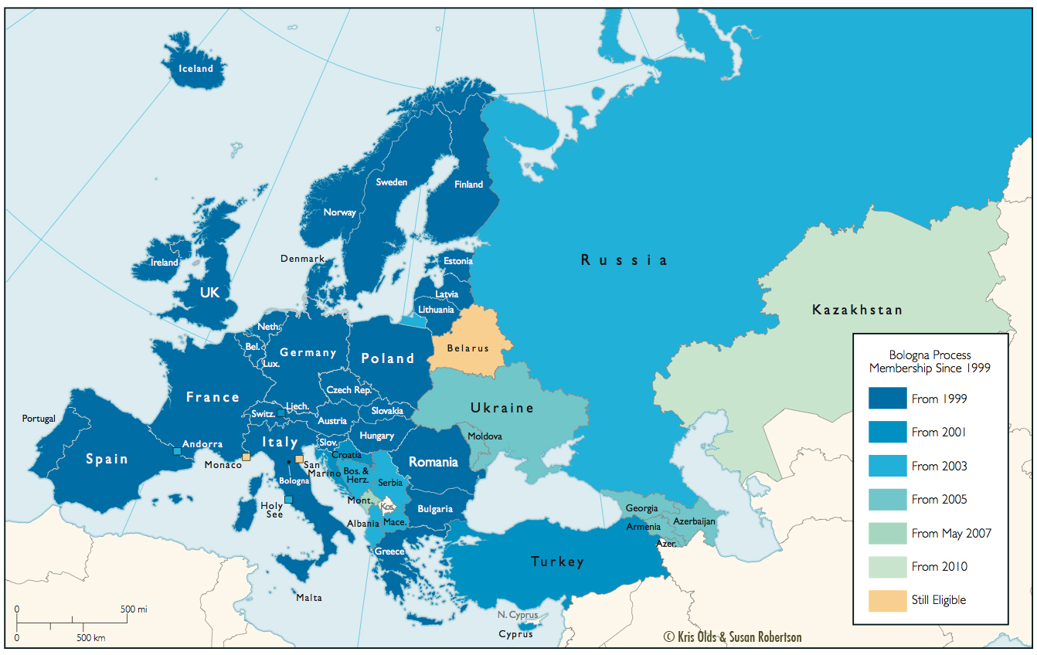
Evolutionary Progress
“A Europe of Knowledge is now widely recognised as an irreplaceable factor for social and human growth and as an indispensable component to consolidate and enrich the European citizenship, capable of giving its citizens the necessary competences to face the challenges of the new millennium, together with an awareness of shared values and belonging to a common social and cultural space”. (Bologna Declaration, 1999)
“The Bologna Declaration in 1999 set out a vision for 2010 of an internationally competitive and attractive European Higher Education Area where higher education institutions, supported by strongly committed staff, can fulfil their diverse missions in the knowledge society; and where students benefiting from mobility with smooth and fair recognition of their qualifications, can find the best suited educational pathways”.
(Budapest-Vienna Declaration on the European Higher Education Area, 2010)

Slide 4
European Higher Education Area: Basics
47 member countries
8 consultative members:
      Higher Education Institutions-EUA EURASHE
      Students and faculty-ESU, EI
      Other stakeholders-ENQA, BUSINESSEUROPE
      International institutions-European Commission, Council of Europe, UNESCO
over 4000 universities
30 mln. student population

Slide 5
BFUG Secretariat
Main role:
“...to provide neutral support to further the consolidation of the European Higher Education Area under the exclusive authority of the BFUG and its Chairs and Vice-Chairs.”
Functions:
Administrative and operational support for BFUG, its sub-structures (WG and networks) and the Board (minute-taking, background documents drafting, assisting chairs in planning the meeting, communication etc.);
Maintaining the EHEA permanent website (www.ehea.info) and electronic archives;
Act as an internal and external contact point for the EHEA, while ensuring dissemination of information on behalf of the Chairs or based on direct requests;
Participate in organising the 2015 Ministerial Conference and Bologna Policy Forum.

Slide 6
BFUG chairing order and timeline
BFUG Chairs:
1 July – 31 December 2012 Cyprus & Bosnia and Herzegovina
1 January - 30 June 201 Ireland & Croatia
1 July – 31 December 2013 Lithuania & Georgia
1 January - 30 June 2014 Greece & Kazakhstan
1 July – 31 December 2014 Italy & Holy See
1 January - 30 June 2015 Latvia & Iceland
BFUG Vice-Chair: Armenia 1 July 2012 – 30 June 2015

Slide 7
Main documents of
Bucharest (2012)
Bucharest Communiqué
Mobility Strategy 2020 for EHEA
Statement of the Third Policy Forum

Slide 8
Main targets of
Bucharest Communiqué (2012)
Quality higher education for all
Enhancing graduates employability
Strengthening mobility for better learning

Slide 9
2012-2015 Work Plan Structures
*Pathfinder Group on Automatic Recognition
*Steering Committee (E4 plus EQAR, EI, BUSINESSEUROPE) on the ESG Revision
*Peer Learning and Review Initiative
*Financing and Governance of HE
Reporting on the Implementati0n of the Bologna Process WG
Ad-hoc WG on the Revision of the ECTS User's Guide
Network on Recognition of Prior Learning (RPL)
Mobility and Internationalisation WG
Network of Experts on Student Support in Europe (NESSIE)
Structural Reforms WG
Social Dimension and Lifelong Learning WG
Network of National Correspondents (NQF)
Ad-hoc WG on the Third Cycle
Ad-hoc WG on Joint degrees and programs
BFUG

Slide 10
Pathfinder Group of Automatic Recognition
Chair: European Commission
“Fair academic and professional recognition, including recognition of non-formal and informal learning, is at the core of the EHEA….. We are determined to remove outstanding obstacles hindering effective and proper recognition and are willing to work together towards the automatic recognition of comparable academic degrees, building on the tools of the Bologna framework, as a long-term goal of the EHEA.”
9 countries: Belgium French Community, BE-Flemish Community, Denmark, Germany, EE, LU, NL, PT, SE, and SI
Focus on academic recognition of bachelor and master degrees- recognition of qualifications at system level.
Use existing Bologna and EU tools with recognition procedures, in particular quality assurance systems, NQFs, ECTS, Diploma Supplement, etc.
recognition also impacts on labour market issues and the group will take account of this where appropriate.

Slide 11
Steering Committee on ESG Revision
Steering Group: EURASHE, ESU, EUA, ENQA, EI, BUSINESSEUROPE and EQAR
“ Develop a proposal for a revised version of the ESG for adoption.”
To improve their clarity, applicability and usefulness, including their scope.
To include developments in learning outcomes and recognition of prior learning.
Structures: Steering Group and Drafting Group of 4 experts( MAP-ESG project)
Thematic session during the Vilnius BFUG meeting.

Slide 12
Structural Reforms WG
QF
QF-EHEA
QA
Recognition
Lisbon Recognition Convention
EAR-manual
EQF for Lifelong Learning
Transparency
QFs, etc.
ECTS User's Guide
Diploma supplement
ESG
EQAR

Slide 13
Evolutionary Progress
The EHEA Ministers have declared in Bucharest:
“We will strive for more coherence between our policies, especially in completing the transition to the three cycle system, the use of ECTS credits, the issuing of Diploma Supplements, the enhancement of quality assurance and the implementation of qualifications frameworks, including the definition and evaluation of learning outcomes.”
Chairs: Council of Europe, Belgium Flemish Community
Holy See, Poland
“
“A Europe of Knowledge is now widely recognised as an irreplaceable factor for social and human growth and as an indispensable component to consolidate and enrich the European citizenship, capable of giving its citizens the necessary competences to face the challenges of the new millennium, together with an awareness of shared values and belonging to a common social and cultural space”. (Bologna Declaration, 1999)
“The Bologna Declaration in 1999 set out a vision for 2010 of an internationally competitive and attractive European Higher Education Area where higher education institutions, supported by strongly committed staff, can fulfil their diverse missions in the knowledge society; and where students benefiting from mobility with smooth and fair recognition of their qualifications, can find the best suited educational pathways”.
(Budapest-Vienna Declaration on the European Higher Education Area, 2010)

Slide 14
Social Dimension and Lifelong Learning WG (I)
Co chairs: ESU and Ireland
We will step up our efforts towards underrepresented groups to develop the social dimension of higher education, reduce inequalities and provide adequate student support services, counselling and guidance, flexible learning paths and alternative access routes, including recognition of prior learning.”
“We encourage the use of peer learning on the social dimension and aim to monitor progress in this area.”
The Ministers further committed to enhance the employability and personal and professional development of graduates throughout their careers. In that regard, they asserted that lifelong learning (LLL) is one of the important factors in meeting the needs of a changing labour market, and acknowledged that higher education institutions play a central role in transferring knowledge and strengthening regional development, including by the continuous development of competences and reinforcement of knowledge alliances.

Slide 15
Social Dimension and LLL -Challenges
Social dimension is understood differently from one country to another.
  National level policies not linked to the Bologna commitment.
  Measurement and monitoring of target groups are not consistent across national boundaries.
However, collecting and comparing more detailed national level data on the social dimension presents real challenges.
It is in this context that the Working Group secured agreement to bring forward a proposal for the Peer Learning Initiative on the Social Dimension of Higher Education.
Working closely with Eurostudent and other initiatives (ES STiME) in the field to avoid re-inventing the wheel.

Slide 16
Mobility and Internationalisation WG (I)
Co-Chairs: Austria, Germany and Spain
To contribute to the implementation of the EHEA Strategy “Mobility for better Learning” at national and European levels and to assist in the reporting to Ministers in 2015 on the progress made
To support countries in their national implementation efforts regarding the mobility strategy.
To contribute to the evaluation of the strategy “EHEA in a Global Setting” and to the further internationalisation of the EHEA.
To review the Bologna Policy concept with the aim of further improving policy dialogue with non-EHEA countries.

Slide 17
Mobility and Internationalisation WG (II)
Portability of grants and loans in the EHEA:
“Sufficient financial support to students is essential in ensuring equal access and mobility opportunities.
We reiterate our commitment to full portability of national grants and loans across the EHEA and call on the European Union to underpin this endeavour through its policies.”
Staff mobility
Fair academic and professional recognition (including informal and non formal learning)
Strive for open higher education systems and better balanced mobility in the EHEA.
International openness to the other regions of the world

Slide 18
Revision of ECTS Users’ Guide
ECTS Users’ Guide should fully reflect the state of on-going work on learning outcomes and recognition of prior learning.
The development, understanding and practical use of learning outcomes is crucial to the success of ECTS, the Diploma Supplement, recognition, qualifications frameworks and quality assurance.
Institutions should further link study credits with both learning outcomes and student workload, and to include the attainment of learning outcomes in assessment procedures.

Slide 19
www.ehea.info
See you in Yerevan on
14-15 May 2015
Thank you !

