Slide 1

Diversity policy
Helen Põllo
Ministry of Education and Research Estonia

Slide 2
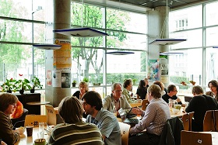

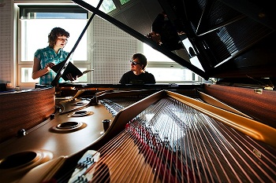

Higher Education in Estonia
Higher education is offered at universities and professional higher education institutions (+ 2 vocational institutions offering professional higher education programmes) = 33 / 29
2 types of first level programmes: professional higher education programmes (3 or 4 years) focusing more on practical studies and bachelor programmes (3 years). Both enabling access to master studies (1 or 2 years). Integrated programmes (5-6 years) in medicine, veterinary etc PhD studies last 3-4 years
69 000 students, 665 curriculums are opened for admission, + 5000 academic teachers

Slide 3
Quality assurance – evaluation of study program groups (2009-2011; 2011+) and accreditation of institutions (2011 +)
U-map
Financing of higher education

Slide 4
U-map excersise
Mapping of Estonian higher education institutions according to the U-Map model took place in 2011.
Not ranking but classification
All HE institutions participated – at least started with the project. Not all of them reached to the end. Not all wanted to be published.
Coatching

Slide 5
Internal experience:
Small country, basicly one reagion.
You can compare what is worth to compare
Ministry has a minor role to play
How do WE understand the indicators and how we present our data?
HaveTHEY given out the right information ?
Result: double quality control (inside one institution and between institutions)
Opens up new discussions about data collection and other transparency tools
Notes:
EHIS

Slide 6
International result?
What will happen when institutions from different countries will be involved?!
Will it have a negative impact?
Will students find the information useful and interesting -will they use it at all? Academic teachers?
Understanding of the results – is the highest rate always the best?

Slide 7
Financing higher education +2012
Based on x nr of indicators measured annually by the MoER
Finding the „right“ indicators to use
profiling institutions
Negotiations

Slide 8
Thank you !
Aitäh!

